Slide 1
Environment Vocab
Let’s Learn…….

Slide 2
Environment Vocab Week 1
Habitat Definition
Adaptation Definition
Migrate Definition

Slide 3
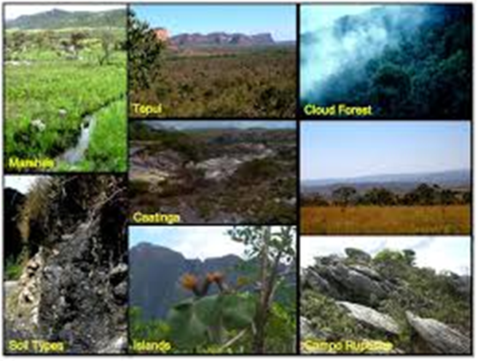
Habitat
The fish’s habitat is a pond.
Definition: the place where one kind of plant or animal can live

Slide 4
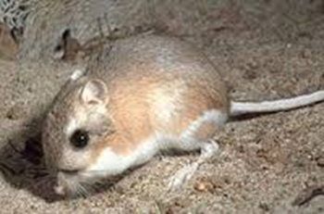
Adaptation
Kangaroo rats have special adaptations for finding water. They get it from seeds they eat.
Definition: feature or way of behaving that helps a living thing to survive in its habitat

Slide 5
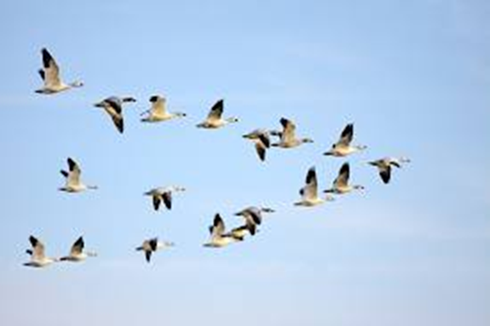
Migrate
Animals migrate to find food or water or to find warm weather.
Definition: they move from one place to another

Slide 6
Hot Environments v. Cold Environments

Slide 7
Writing Prompt:
Pick an extreme environment. What adaptations it would take to live there?

Slide 8
Types of Environments
Tundra
Alpine
Deep Ocean
Desert

Slide 9
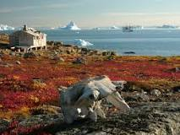
Tundra
Low Temperatures
Short growing season
Dry, Cold, and Windy

Slide 10
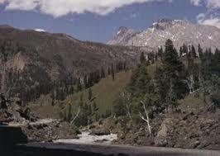
Alpine
High altitudes
Low temperatures
Short growing seasons
Lots of light since atmosphere is thin

Slide 11
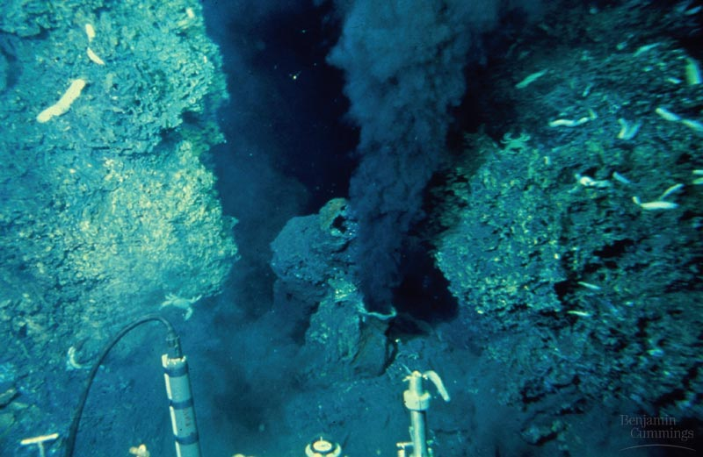
Deep Ocean
Very Dark
Lots of Pressure
Extremely Cold
Lots of oxygen in the water

Slide 12
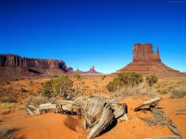
Desert
Very little rain
Very hot during the day and cold at night

